Slide 1

Employee Absenteeism Clustering

Slide 2
As per the Clustering Model Following Factors are Responsible:
Work load Average/day.
Distance from Residence to Work.
Social Drinker Or Not.

Slide 3
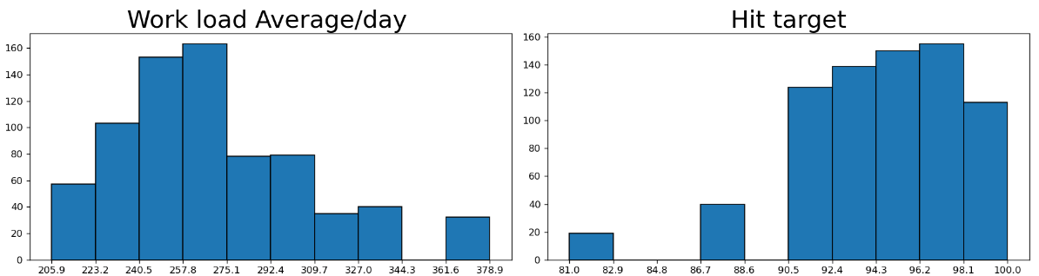
WorkStress is The Key Factor Here..

Slide 4
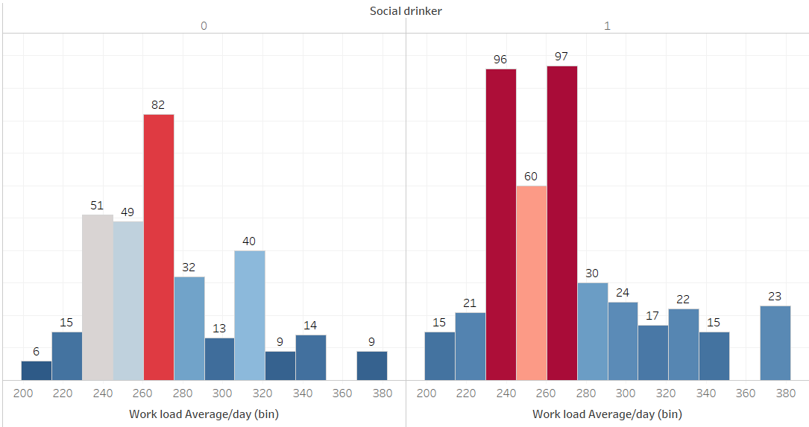
Alcohol Being a Boon and Bane Company
Alcohol increases the chances of heart attack by 40%.

Slide 5
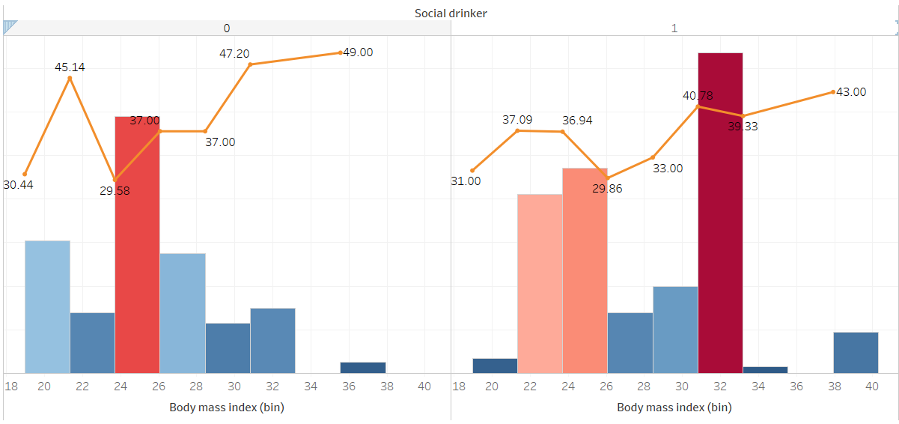
Employees Not Healthy.

Slide 6
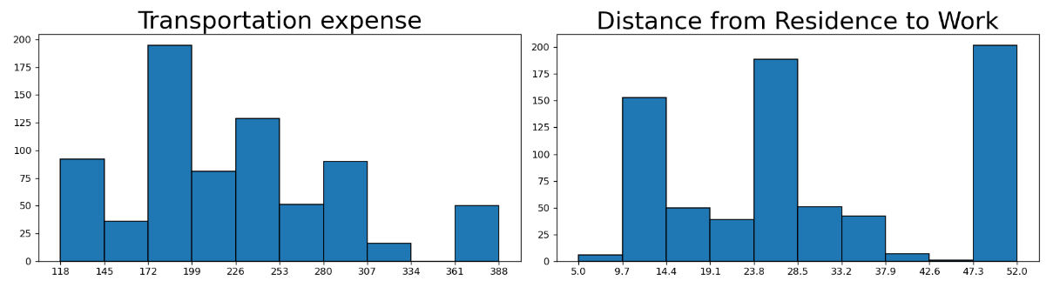
Evidence:

Slide 7
The Story
Mr.John being a seasoned employee at your whose ambitious and dedicated.
Believes in doing good is work key factor for success.
With times he has molded himself for optimum function.
He can handle greater workload,work for long hours and at end of the day uses alocohol as a stress reliever.Which in due time becomes an habit.
Afterwork he prefers to have drinks to let of stress.He reaches home and sleeps,next day he is hungover, the greater distance makes him even late.
He comes late may be didn’t cope up with the day, the stress triggers in and he thinks ,The day is wasted and leaves early.

Slide 8
Suggestions..
To be noted majority of these employees have no disciplinary faults.
Better Distribution of the work load.
Encouraging or providing employees housing near the workplace.
Indulging the employees in better health activities.
Close watchout on the yearly health reports of employees.
Psychometric Evaluation a must all employees.

